Slide 1

Private Blockchain – An new approach to solve supply chain problems
Techcon 2019
Quang Nguyen
Software Engineer
Ho Chi Minh City, October 12th, 2019

Slide 2
Agenda
Introduction
CoffeeNet supply chain
Public blockchain and Private blockchain
Hyperledger Fabric
3-tier architecture
Simple demo
HLF Solution – Business approach

Slide 3
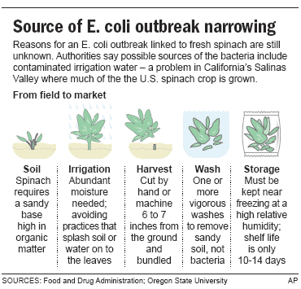
Introduction
Agriculture Supply Chain problems
1
Food contamination, lack of origin
Notes:
Vấn đề lớn nhất là thực phẩm bẩn được đi kèm với ko rõ nguồn gốc. Ví dụ bùng phát vi khuẩn ecoli. Đây là 1 loại vi khuẩn chết người. 10/6/2006, căn bệnh từ rau bina bị hư từ California đã lan rộng ra đến 24 bang. Gần 200 người bị bệnh – một phần ba trong số này nhiễm bệnh chỉ trong vòng 72 giờ đầu tiên. 3 người đã chết. Dừng bán mặt hàng . Tại thời điểm đó mọi hoạt động mua bán rau bina tại các siêu thị, tiểu thương đều bị ngăn chặn. Việc này tất nhiên gây tổn thất rất lớn và mất đến 2 tuần sau thì tổ chức FDA mới phát hiện ra nguồn gốc của vấn đề. Chỉ vì một lô sản xuất của một nông trại tiểu bang cali đã gây ra thiệt hại lớn đến thế này.

Slide 4
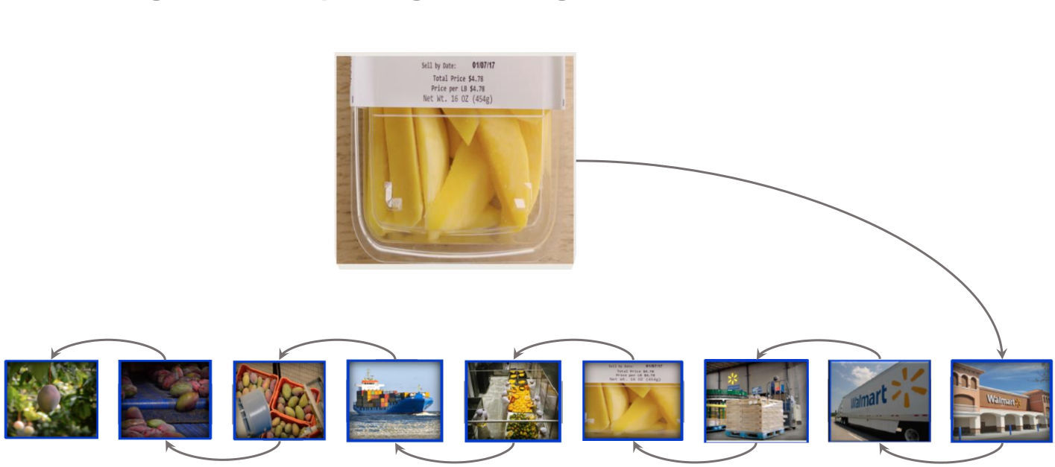
Introduction
Agriculture Supply Chain problems
2
It takes too long to determine the source of contamination
6 days 18 hours and 26 minutes
Notes:
Secondly, It takes too long to determine the source of contamination. For example, this is Walmart supply chain. In order to conduct a traceback test on mangoes in one of its stores. It took six days, 18 hours and 26 minutes to trace mangoes back to the originating farm. Obviously it is too long, while the their customers wants to ensure that the product they intend to buy has a clear origin at the time of purchase.
https://www.forbes.com/sites/rogeraitken/2017/08/22/ibm-forges-blockchain-collaboration-with-nestle-walmart-for-global-food-safety/#5b0121833d36

Slide 5
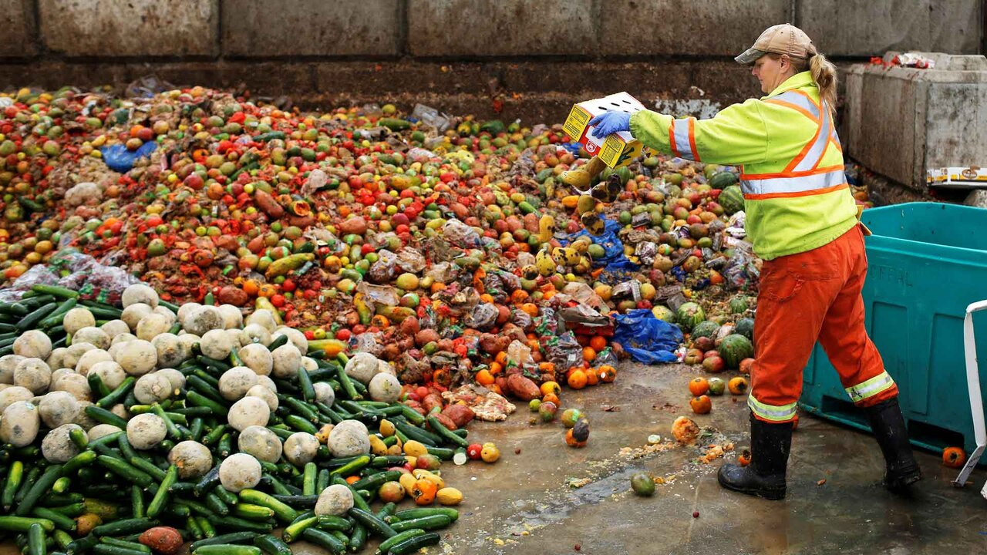
Introduction
Agriculture Supply Chain problems
3
Highly perishable, wasting foods
Notes:
Europe 3-4$%
Finally, according to the data we study, Vietnam is currently wasting 31% of food each year, including 26% being damaged in post-harvest(mean supply chain processing) due to many reason
Asean,china , Vietnam more than 31% wasting food

Slide 6
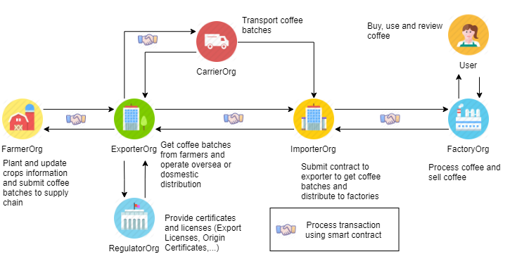
CoffeeNet supply chain process
Overview
CoffeeNet Supply Chain Parties and Roles
Notes:
7 org: Farmer, Exporter, Regulator, Carrier, Importer, Factory and User illustrated by icons
---> introduce role of each org
Arrow: operation from requester to receiver (data flow)
Handshake icon: operation between those 2 org uses smart contract

Slide 7
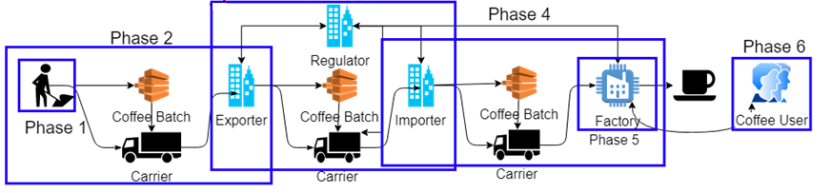
CoffeeNet supply chain process
Processes
6 phases and 3 smart contracts
Planting
Collecting
Exporting
Buying
Processing
Consuming
Contract Step 1
Contract Step 2
Contract Step 3
Notes:
Supply chain are divided into 6 phase
3 smart contracts will be created in each of phase 2,3,4
Why those phases need have smart contract? Related to transport and trade coffee batch, those step all involves CarrierOrg

Slide 8
Solution as a Black Box
Input & Output defined
Not transparent
Supply chain system
Transparency
Blockchain
No traceability
Traceability resource
Hard to monitor package or Farm
Internet of Things
Remote monitoring
Notes:
In this project, we will solve these problems by designing a blackbox system. This system is built up from Blockchain and IoT technology

Slide 9
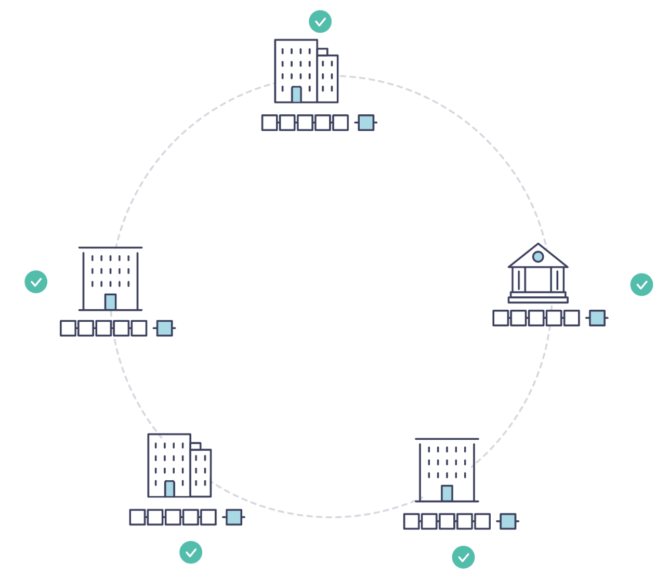
Blockchain Network
Why difference
Modernise your business problem
A system of record that spans a business network
Standard methods for establishing identity on the network
Executing transactions, and storing data
Notes:
From stone tablets and paper folders to hard drives and cloud platforms but the underlying structure is the same
This is a blockchain network, wherein every participant has their own replicated copy of the ledger. In addition to ledger information being shared, the processes which update the ledger are also shared. Unlike today’s systems, where a participant’s private programs are used to update their private ledgers, a blockchain system has shared programs to update sharedledgers.

Slide 10
Blockchain Network
Benefits
Reduce the time, cost, and risk associated with private information and processing
Improving trust and visibility.

Slide 11
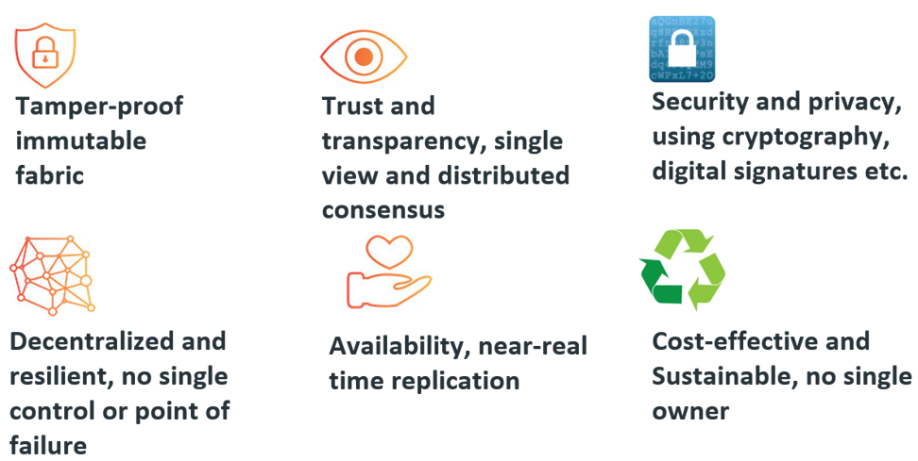
Blockchain
Characteristics
Notes:
First, tamper-proof immutable make immutability records, the record(transaction) once it written, it cannot change its states (because blocks are linked to its previous block, cannot be changes)
Second, it also increases transparency because all transaction are viewable in blockchain. The decentralized of DLT system is record in multiple locations. Having the same records spread across a large network for all to see is the core of blockchain transparency.
Third, it is security and privacy because it apply cryptography and digital signature (PKI implementation)
Fourth, generally, blockchain use decentralized model, so it is more resilient because it doesn’t depend on single unit, and also no single point of fail make system fault-tolerance betters
Finally, due to decentrzlied system, it doesn’t have a single owner, every organization that built up the blockchain is co-owner, they’re equality
Consensus - No transactions happen in isolation.
Provenance - Historical track of transactions
Immutability - Data and transactions recorded cannot be altered
Finality - A transaction achieves settlement finality when it has completed, and there is no chance of it reverting or changing state again.
https://www.mf2c-project.eu/what-is-a-blockchain/
https://www.linkedin.com/pulse/use-cases-blockchain-vinod-pai

Slide 12
Blockchain
Public BC versus Private BC
  Permissioned networks place restrictions on who is allowed to participate in the network and in what transactions.
Public | Private
Open | Restricted, KYC, join via invitation
Transaction speed is slow | Transaction speed is fast
No trust environments | Member within orgs need to trust each other
Byzantine fault tolerant | Crash fault tolerant
Large energy consumption | Low energy consumption
Notes:
The open versus closed brings in to consideration who’s able to read that data.
And so, we can talk about solutions which are public and open, public and closed, private and open, private and closed.
PublicBC still can build up a permission scenarios or to control access data, but it’s doesn’t have built-in tools, make it hard to develop for a developer
PrivateBC is a leverage for business use case

Slide 13
Blockchain
Private BC
Advantages:
  Identity is a hard requirement (KYC & AML)
  High TPS
  Scale easily
Disadvantages:
  Not a fully decentralized system

Slide 14
Solution
Traditional versus Private Blockchain
 | Traditional centralized system | Private Blockchain
Provenance | Laborious | Fast tracking and strongly security
Contract | Must be signed and executed manually | Smart Contract
Consistency | Consistent | Eventual consistency
Transparency | Difficult | Be able to view transactions easily
Weak points | SPOF | Not suitable for small system
Notes:
It takes days to clear securities transactions
What if, instead of the rat’s nest of inefficiencies represented by the “modern” system of transactions, business networks had standard methods for establishing identity on the network, executing transactions, and storing data? What if establishing the provenance of an asset could be determined by looking through a list of transactions that, once written, cannot be changed, and can therefore be trusted?
There is a huge amounts of inefficiency (and therefore value opportunity) in many industries caused by different companies holding separate versions of data. These versions get out of sync with the same duplicate records being held by other companies. This duplication increased costs, leads to errors/disputes and delays. The blockchain enables companies to share one version of the data. Yes this comes with trade-offs (transaction throughput, speed) but this needs to be balanced against the increase in operational and infrastructure costs that will be gained.
Furthermore by sharing a ledger this increases transparency between the participants and organisations which improves trust.
Distributed: The processing is shared across multiple nodes, but the decisions may still be centralized.
Decentralized: There is no single point where the decision is made.
Each entity in the supply chain is independent of each other, corresponding to each node of the decentralized system

Slide 15
Blockchain
Applying Private BC into Food Supply Chain
What it does:
  Recording the quantity of the products and its transfer through different parties.
  Tracking all the purchase orders, change orders, receipts, trade-related details
  Helps in the sharing all the information about the manufacturing process, assembly, delivery, and maintenance of products with the different parties in the supply chain.
Notes:
- Eg. this can be used to track whether a particular item meets certain quality standards or not
- It can link various physical items to serial numbers, barcodes, and tags like RFID etc.

Slide 16
Blockchain
Applying Private BC into Food Supply Chain
Benefits:
  Data Consistency, Transparency between organizations
  Reducing overhead cost
  Reducing Time delays, Human error
  Greatly enhances food safety
  Ensures fresher food since no one will risk sending “non-fresh” food in an open system
  Promotes responsibility among the food producers
Notes:
Blockchain’s transparency helps in the careful documentation of a product’s journey from its point of origin to all its suppliers. This increases the trust among the various parties in the supply chain because all the data is visible for everyone to see.
The blockchain network can take in any and all participants of the supply chain network. Plus, regardless of their geographical location, everybody will be able to connect with the blockchain.
Blockchain’s immutability will make sure that all the records in the chain are honest and free from corruption. Plus, the strong security from its innate cryptography will eliminate unnecessary audits, saving copious amounts of time and money.

Slide 17
Hyperledger Fabric
Definition
Hyperledger Fabric is a blockchain framework implementation
Permissioned
Modular design
No DSL
Accepting authorized member
Appropriate business scenario
No Domain Specific Language require
Notes:
Secondly, its design highly modular, again, in business scenario, this is also very important because the logic, the system, the contract of agreement are changed unexpectedly, a modular system make changes easier based on agreement contract.
Solution and application architect
Client application developer
Smart contract developer
Business professional

Slide 18
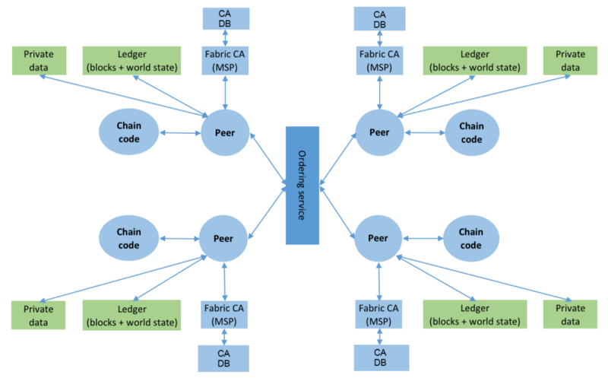
Hyperledger Fabric
Architecture
Notes:
In this picture, we can see that a system using Fabric as main framework entirely. 3 main components that we care the most is Peers, FabricCA and Ordering Service. we will delve into these components

Slide 19
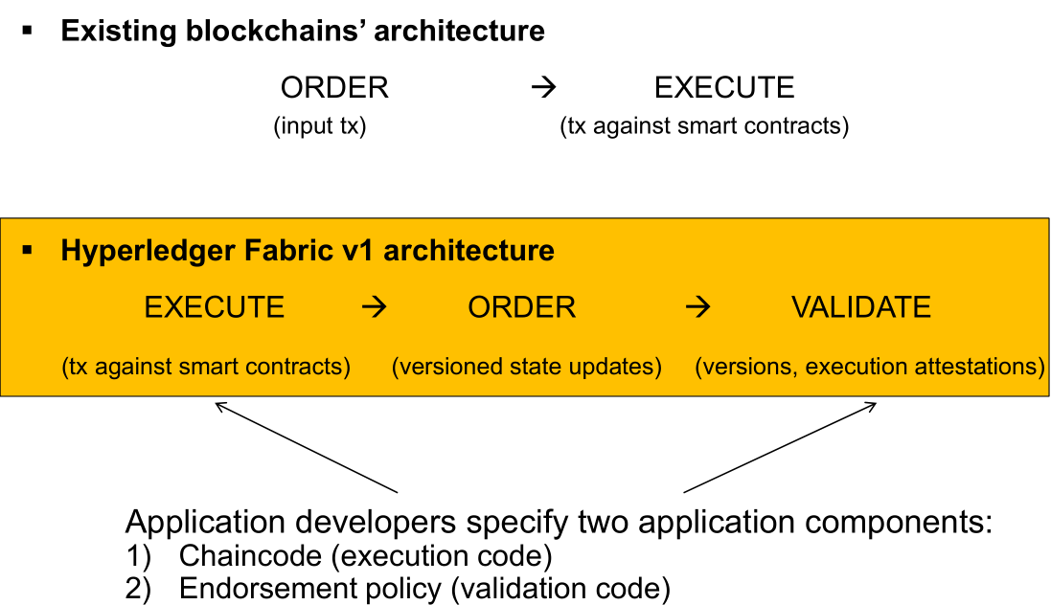
Hyperledger Fabric
Execute -> Order -> Validate
Notes:
execute a transaction and check its correctness, thereby endorsing it,
order transactions via a (pluggable) consensus protocol, and
validate transactions against an application-specific endorsement policy before committing them to the ledger
Sequential execution of smart contracts
─ long execution latency blocks other smart contracts, hampers performance
─ DoS smart contracts (e.g., infinite loops)
Gas and tied to a cryptocurrency
Confidentiality of execution: all nodes execute all smart contracts
Inflexible consensus: Consensus protocols are hard-coded

Slide 20
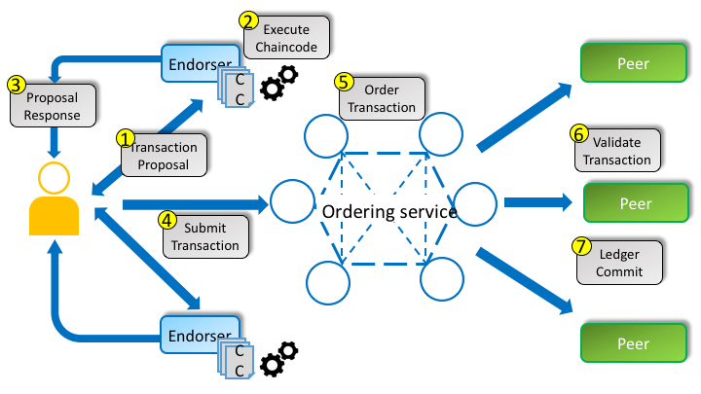
Application’s Architecture
Transaction flow
Notes:
Refer to medium page
TBU

Slide 21
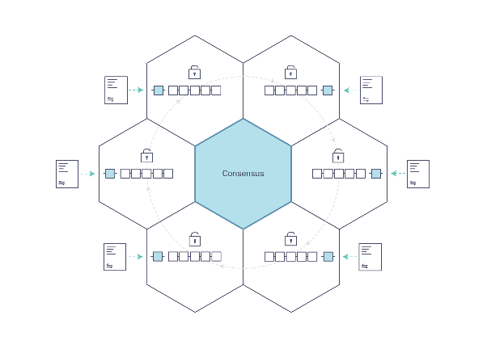
Hyperledger Fabric
Consensus
Allow a collection of machines to work as a coherent group that can survive the failures of some of its members.
Now failure can be majorly two types:
Non-Byzantine: network down.
Byzantine: malicious actors, non-byzantine faults include.
Notes:
http://thesecretlivesofdata.com/raft/

Slide 22
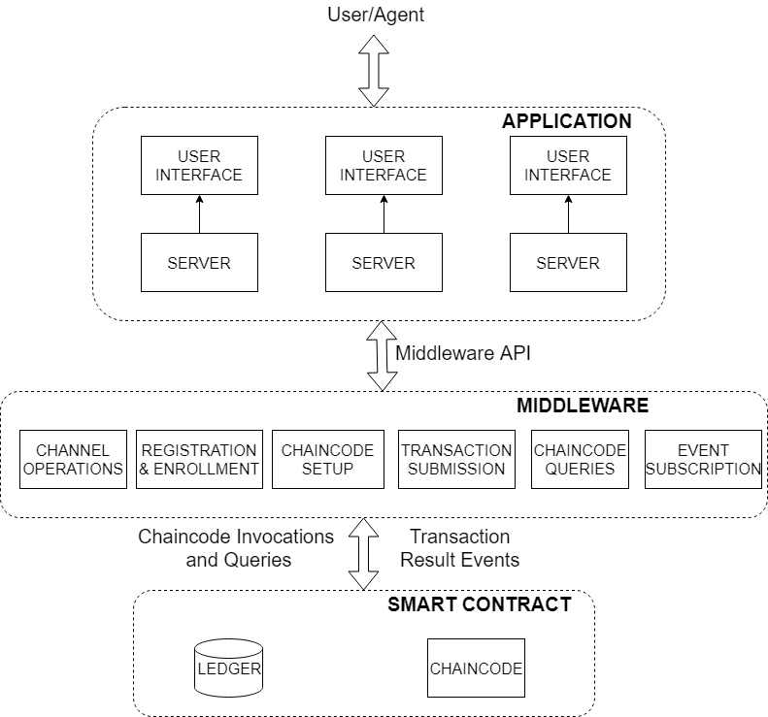
Fabric Application Structure
3-tier architecture
Operate directly on shared ledger
Run on network peers
Expose service API for invocation and queries
Publishing event notifications of transaction result.
Notes:
At the lowest layer lies the smart contract that operates directly on the shared ledger, which may be written using one or more chaincode units. These chaincodes run on the network peers, exposing a service API for invocations and queries, and publishing event notifications of transaction results, as well as configuration changes occurring on the channel.

Slide 23
Hyperledger Application Structure
3-tier architecture
Orchestrate the various stages of a blockchain application
Subscribe to transaction and configuration-related events emanating from the network
Notes:
In the middle layer lies the functions to orchestrate the various stages of a blockchain application. Hyperledger Fabric provides an SDK (currently available in Node.js as well as in Java) to
perform functions such as channel creation and joining, registration, and enrollment of users, as well as chaincode operations.
In addition, the SDK offers mechanisms to subscribe to transaction and configuration-related events emanating from the network. Depending on application needs, an off-chain database may be maintained for convenience, or as a cache of ledger state.

Slide 24
Hyperledger Application Structure
3-tier architecture
Service API consisting mostly of application-specific capabilities
User interface should be designed for ease to use
Notes:
At the topmost layer lies a user-facing application that exports a service API consisting mostly of application-specific capabilities, though administrative operations such as channel and chaincode operations may also be exposed for system administrators. Typically, a user interface should also be provided for ease of use, though a well-defined API may suffice if the user is a software agent.

Slide 25
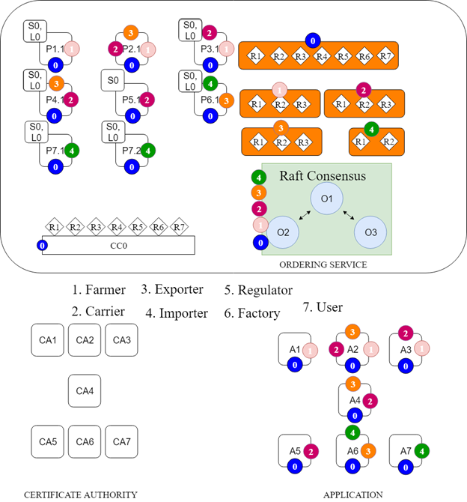
Solution
Notes:
TODO:
Giải thích 1 số thành phần
Tiến hành Demo
Mục đích: Show được rằng các transaction là transparency

Slide 26
HLF Solution
Business approach
Prepare step:
  Define network and participants.
  Define actors and business.
  What benefits you think blockchain bring to your business ?
  Define business logic.

Slide 27
HLF Solution
Business approach
TODO step:
  At each entity, setup Fabric Node, CA Server,..
  Smart contract developer will inject business logic process and Attribute-based access control into SC.
  Installing / updating and deploying smart contract continuously (Dev-ops)
  Deciding which capabilities should be exposed for SA
  Perform testing to ensure that your business logic which implement on Smart Contract work flawlessly
Notes:
Mock-test builtin support for unit testing
To develop middleware, you must decide which capabilities to expose for System admin user to manage system (Full-control and Not break blockchain)

Slide 28


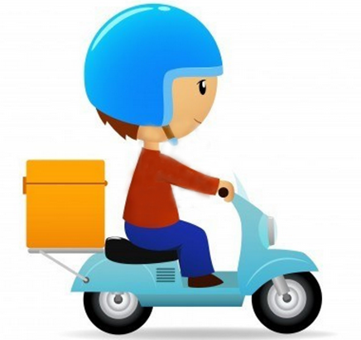


HLF Solution
Simple case
Consistency
Trace source of problems
Reduce overhead cost
Food supplier (Restaurant)
User
(Government)
Carrier
(Shipper)
Notes:
Benefit: Dữ liệu đồng nhất, truy xuất nguồn gốc vấn đề, giảm chi phí
Network: food supply network
Participant: Food supplier, Carrier, User
Business: Vận chuyển thực phẩm đảm bảo không bị đánh tráo trong quá trình vận chuyển và ko xảy ra những trường hợp dữ liệu không đồng nhất. Truy xuất nguồn gốc vấn đề

Slide 29
HLF Solution
Define business logic
2. Order confirmation
8. Feedback
1. Order food
Food supplier (Restaurant)
7. Confirm
3. Prepare food
User
4. Deliver food to Carrier
5. Confirmation
6. Deliver food to user
Carrier
(Shipper)
Notes:
Business logic:
Món ăn( )
Client: Đặt thức ăn, Thanh toán hay hủy đặt
Shipper:
Nhà cung cấp: Xác nhận đơn hang, chuẩn bị món, đóng gói và xác nhận sẵn sàng vận chuyển

Slide 30
HLF Solution
Setup and Deploy
Food supplier (Restaurant)
Carrier
(Shipper)
User
(Government)
O1
P1
O2
P2
O3
P3
L0 / S0
CA1
L0 / S0
CA2
L0 / S0
CA3
Channel 0
Notes:
Business: Vận chuyển thực phẩm đảm bảo không bị đánh tráo trong quá trình vận chuyển và ko xảy ra những trường hợp dữ liệu không đồng nhất. Truy xuất nguồn gốc vấn đề

Slide 31
Summary
In this session, we talked about:
  How differences between public blockchain and private blockchain ?
  What is Hyperledger Fabric platform ? What can it does ? How it different from other Blockchain ?
  3-tier architecture for developing application
  A simple demo using HLF for supply chain process leverage
  How to approach HLF solution with your business.
  A simple case
Notes:
Lean Enablers = Lean Program Management best practices
Business case: Compare costs directly with benefits (effort vs. Increased margin/productivity, lower inventory etc.)
Outlook: attach money data to benefits → difficulty of comparability

Slide 32
References
Linux Foundation, Hyperledger Docs, https://hyperledger-fabric.readthedocs.io/en/latest/ , Accessed on 08/12/2019
Nitin Gaur, Luc Desrosiers,... Hands-On Blockchain with Hyperledger, Packt Publishing, 2018
Imran Bashir, Mastering Blockchain, Packt Publishing, 2017
Quang Nguyen, Nguyen Nguyen, Designing Coffee Supply Chain System using Blockchain and Internet of Things, 2019
Notes:
Lean Enablers = Lean Program Management best practices
Business case: Compare costs directly with benefits (effort vs. Increased margin/productivity, lower inventory etc.)
Outlook: attach money data to benefits → difficulty of comparability

Slide 33
Feedback & Support
Telegram: https://t.me/duyquang6
Blog: https://medium.com/@duyquang6
Email: nguyenduyquang06@gmail.com
Notes:
Lean Enablers = Lean Program Management best practices
Business case: Compare costs directly with benefits (effort vs. Increased margin/productivity, lower inventory etc.)
Outlook: attach money data to benefits → difficulty of comparability

Slide 34
Thank you!
Q & A Section

Slide 35
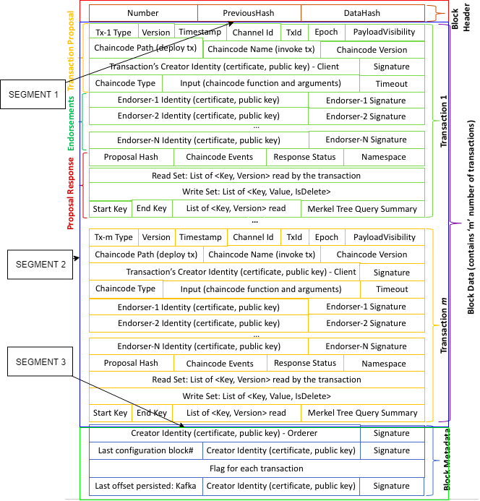
Hyperledger Fabric
Block structure
Notes:
https://stackoverflow.com/questions/52194196/change-default-hash-function-for-block-hashing
https://github.com/hyperledger/fabric/blob/release-1.4/protos/common/block.go
No merkle tree implement available, only concenate bytes then compute SHA256

Slide 36
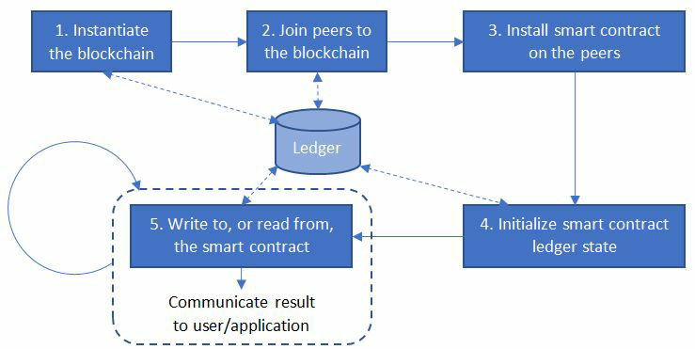
Application’s Architecture
Transaction stages

Slide 37
Transaction Flow
Endorsement Phase: Step 1 – Propose transaction
Client Apps
SDK
Endorsment Policy: P0, P1, P2, P3 must sign transaction
0
0
P0
0
P2
S0
O1
O2
S0
O3
Client send application submits a transaction proposal
S0
S0
P1
P3
0
0
0

Slide 38

Transaction Flow
Endorsement Phase: Step 2 – Execute proposal
Client Apps
SDK
Peers will each execute the proposed tx. None of these executions will update ledger
Each execution will capture the set of Read and Written data, called RW sets, which will now flow in the fabric
Transaction can be signed & encrypted
0
0
P0
0
P2
S0
O1
O2
S0
O3
S0
S0
P1
P3
0
0
0

Slide 39
Transaction Flow
Endorsement Phase: Step 3 – Proposal response
Client Apps
SDK
RW sets are asynchronously returned to application
The RW sets are signed by each endorser and also includes each record version number
0
0
P0
0
P2
S0
O1
O2
S0
O3
S0
S0
P1
P3
0
0
0

Slide 40
Transaction Flow
Endorsement Phase: Step 4 – Order transaction
Client Apps
SDK
Application submits responses as a transaction to be ordered.
Ordering happens across the fabric in parallel with transactions submitted by other applications
0
0
P0
0
P2
S0
O1
O2
S0
O3
S0
S0
P1
P3
0
0
0
Other applications

Slide 41
Transaction Flow
Endorsement Phase: Step 5 – Deliver transaction
Client Apps
SDK
Ordering service collects transactions into proposed blocks for distribution to comitting peers.
Peers can deliver to other peers
0
0
P0
0
P2
S0
O1
O2
S0
O3
S0
S0
P1
P3
0
0
0

Slide 42

Transaction Flow
Endorsement Phase: Step 6 – Validate transaction
Client Apps
SDK
Every committing peer validates against the endorsement policy. Also check RW sets are still valid for current world state
0
0
P0
0
P2
S0
O1
O2
S0
O3
S0
S0
P1
P3
0
0
0

Slide 43


Transaction Flow
Endorsement Phase: Step 7 – Commit transaction
Client Apps
SDK
Validated transactions are applied to the world state and retained on ledger
Invalid transactions are also retained on ledger but do not update world state
0
0
P0
0
P2
S0
O1
O2
S0
O3
S0
S0
P1
P3
0
0
0
Notes:
Applications can register to be notified when transactions succeed or fail, and when blocks are added to ledger.
Applications will be notified by each peer to which they are connected

Slide 44
Bootstrap network
Step 1: Instantiate the blockchain
O1
O2
O3
An orderer is configured and started on the network

Slide 45
Bootstrap network
Step 1: Instantiate the blockchain
P0
P2
O1
O2
O3
P1
P3
Peers are configured and started on the network

Slide 46
Bootstrap network
Step 1: Instantiate the blockchain
P0
P2
P0
0
O1
O2
O3
P1
P3
P1
0
Channel 0 is created and linked to Ordering Service

Slide 47
Bootstrap network
Step 2: Join channel
0
0
P0
0
P2
O1
O2
O3
P1
P3
0
0
0
Peers join channel 0, begin communication

Slide 48
Bootstrap network
Step 3: Install chaincode
0
0
P0
0
P2
S0
O1
O2
S0
O3
S0
S0
P1
P3
0
0
0
Chaincode is installed onto each Endorsing Peer that need to execute it

Slide 49
Bootstrap network
Step 4: Instantiate chaincode
0
0
P0
0
P2
S0
O1
O2
S0
O3
S0
S0
P1
P3
0
0
0
Peers finally instantiate the chaincode on the channel they want to transact on

Slide 50

Bootstrap network
Step 5: Write or Read from Smart Contract
0
0
P0
0
P2
S0
O1
O2
S0
O3
S0
S0
P1
P3
0
0
0
Client send transaction to begin transaction flow and update ledger state

Slide 51
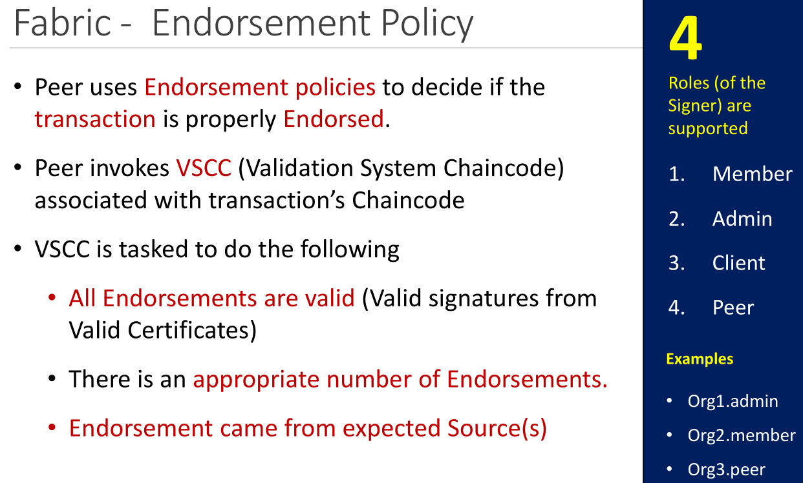
Hyperledger Fabric
Components: Endorsment Policy
Notes:
https://medium.com/@spsingh559/detail-analysis-of-raft-its-implementation-in-hyperledger-fabric-d269367a79c0

Slide 52
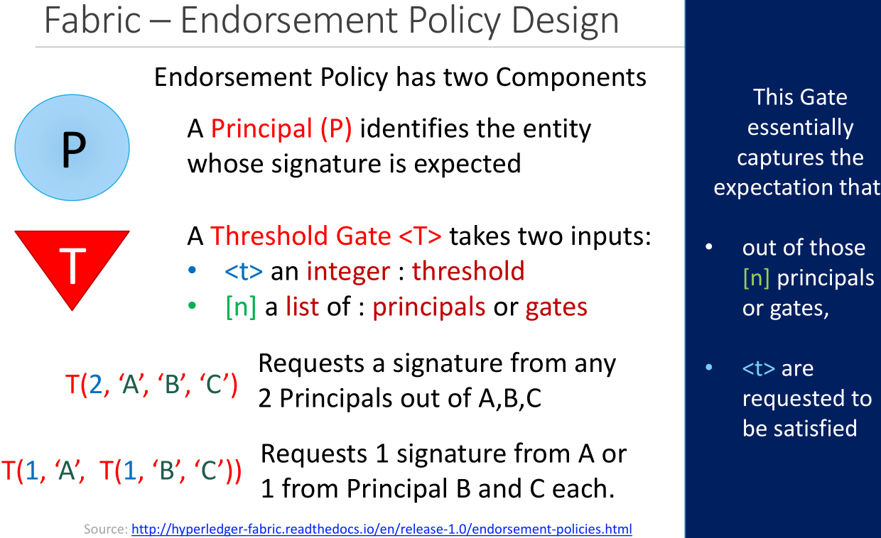
Hyperledger Fabric
Components: Endorsment Policy
Notes:
https://medium.com/@spsingh559/detail-analysis-of-raft-its-implementation-in-hyperledger-fabric-d269367a79c0

Slide 53
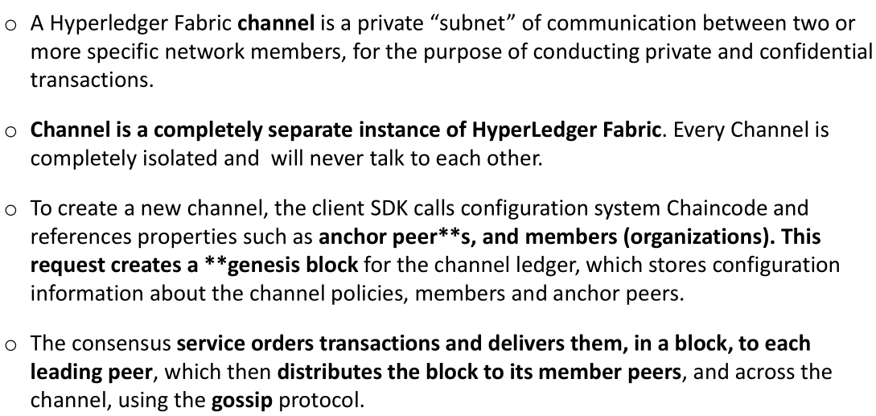
Hyperledger Fabric
Channel
Notes:
https://medium.com/@spsingh559/detail-analysis-of-raft-its-implementation-in-hyperledger-fabric-d269367a79c0

Slide 54
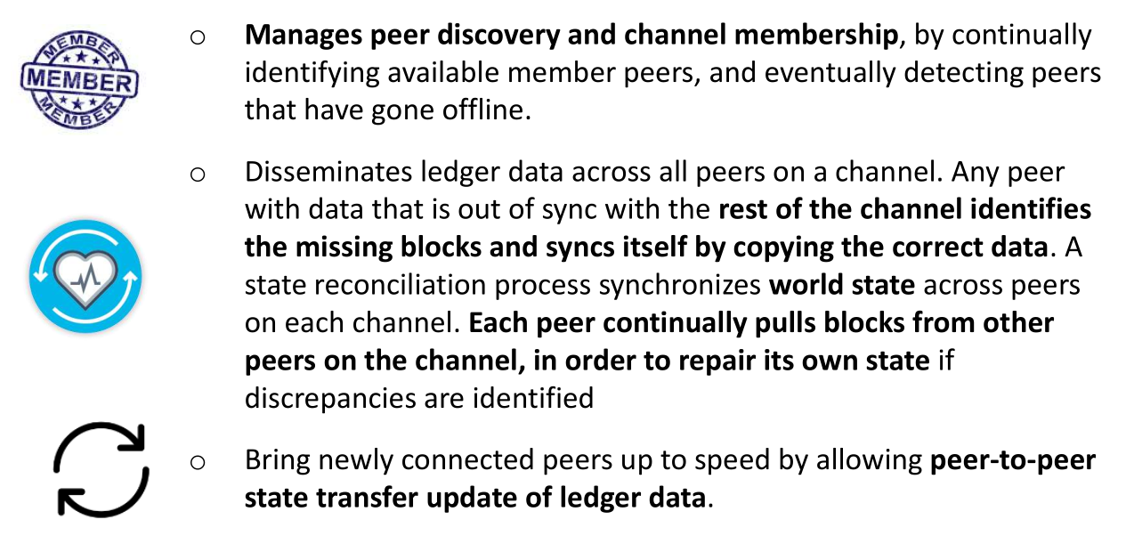
Hyperledger Fabric
Gossip Protocol
Notes:
https://medium.com/@spsingh559/detail-analysis-of-raft-its-implementation-in-hyperledger-fabric-d269367a79c0

Slide 55
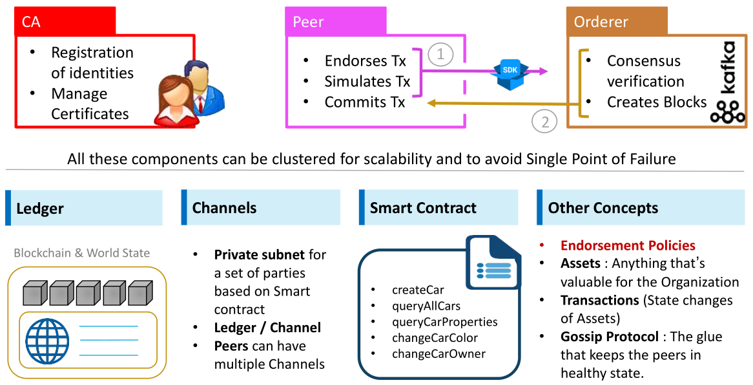
Hyperledger Fabric
Main components

Slide 56
Certificate:
Data:
Version: 3 (0x2)
Serial Number:
45:28:67:9e:1c:c1:37:d2:ba:85:3d:5e:76:cf:97:ba:fb:fe:b4:53
Signature Algorithm: ecdsa-with-SHA256
Issuer: C=US, ST=California, L=San Francisco, O=regulatororg.trade.com, CN=ca.regulatororg.trade.com
Validity
Not Before: May 5 01:29:00 2019 GMT
Not After : May 4 01:34:00 2020 GMT
Subject: OU=client, OU=org1, OU=department1, CN=nguyenduyquang06@gmail.com
Subject Public Key Info:
Public Key Algorithm: id-ecPublicKey
Public-Key: (256 bit)
pub:
04:fc:43:47:a5:31:5c:6a:b5:f6:f3:c3:9b:7e:d5:
36:f7:1e:ad:d6:cb:52:dc:02:97:26:06:b7:2b:3e:
9e:e2:d7:67:b1:72:f8:9a:58:10:b9:7c:95:71:24:
4b:98:d1:45:b4:d5:f1:ca:52:7f:96:bf:c6:12:59:
9e:59:0c:b4:d3
ASN1 OID: prime256v1
X509v3 extensions:
X509v3 Key Usage: critical
Digital Signature
X509v3 Basic Constraints: critical
CA:FALSE
X509v3 Subject Key Identifier:
DC:9C:A1:2B:B0:DB:B0:93:35:56:DC:A8:C7:F2:54:EE:13:45:AE:A4
X509v3 Authority Key Identifier:
keyid:A8:13:B7:85:36:80:AB:B4:51:AA:15:EF:47:79:30:9B:CE:EC:20:90:43:BE:4B:AA:F8:6B:F9:FE:90:BB:2A:F8
1.2.3.4.5.6.7.8.1:
{"attrs":{"active":"true","address":"12 Street number 31 Ward 5 District 8","city":"Ho Chi Minh","country":"VN","email":"nguyenduyquang06@gmail.com","ethAddress":"0x58d04e635d4dba039d69533dc6525330ffa09be5","fullName":"Nguyen Duy Quang","hf.Affiliation":"org1.department1","hf.EnrollmentID":"nguyenduyquang06@gmail.com","hf.Type":"client","password":"$2b$10$GtAM6V/940kAzkE6R3DrEe12x9n72lECgJhNNmojjsypzt9O0a41i","role":"admin","state":"Ho Chi Minh, thanh pho","zipCode":"70000"}}
Signature Algorithm: ecdsa-with-SHA256
30:45:02:21:00:ac:4c:66:3b:49:ad:3d:7e:18:90:65:fc:32:
27:d4:a3:35:b6:71:02:9f:c9:1a:8b:07:bb:71:16:fa:ca:95:
1a:02:20:3f:d0:99:be:07:be:78:a9:91:22:06:89:e9:53:a8:
0b:80:68:e9:9a:23:45:c8:8c:b0:31:30:4c:bb:ef:7f:18
Notes:
LDAP: https://viblo.asia/p/network-tim-hieu-ldap-cau-hinh-xac-thuc-ssh-voi-ldap-zoZVRgdZMmg5

